Slide 1
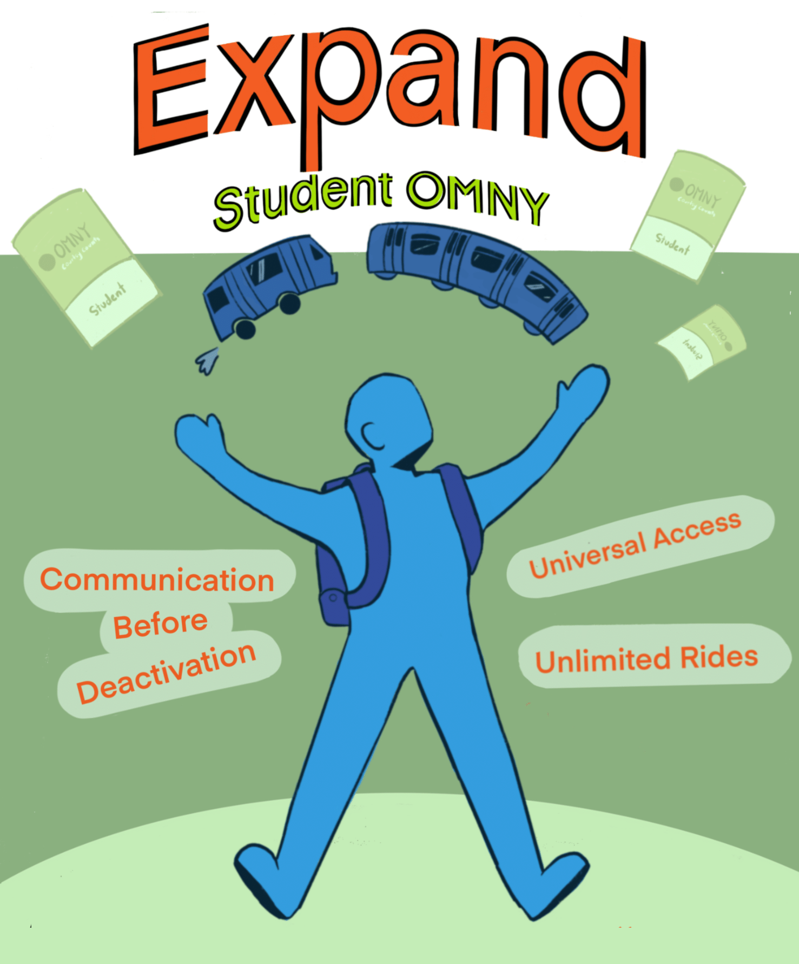


Expanding Student
OMNY
August Hoyt
Bard High School
Charlie Hawn
Bronx High School of Science

Slide 2
Our Campaign Asks
OMNY cards given to all NYC students without eligibility limitations
Universal Access
Students able to explore without ride cap will help reduce encounters with police
Unlimited Rides
Greater transparency between MTA, NYCPS schools, and students
Communication on Deactivations
Minimize supply chain issues to ensure students have a reliable way home; eliminate paper cards
Faster Card Replacement

Slide 3
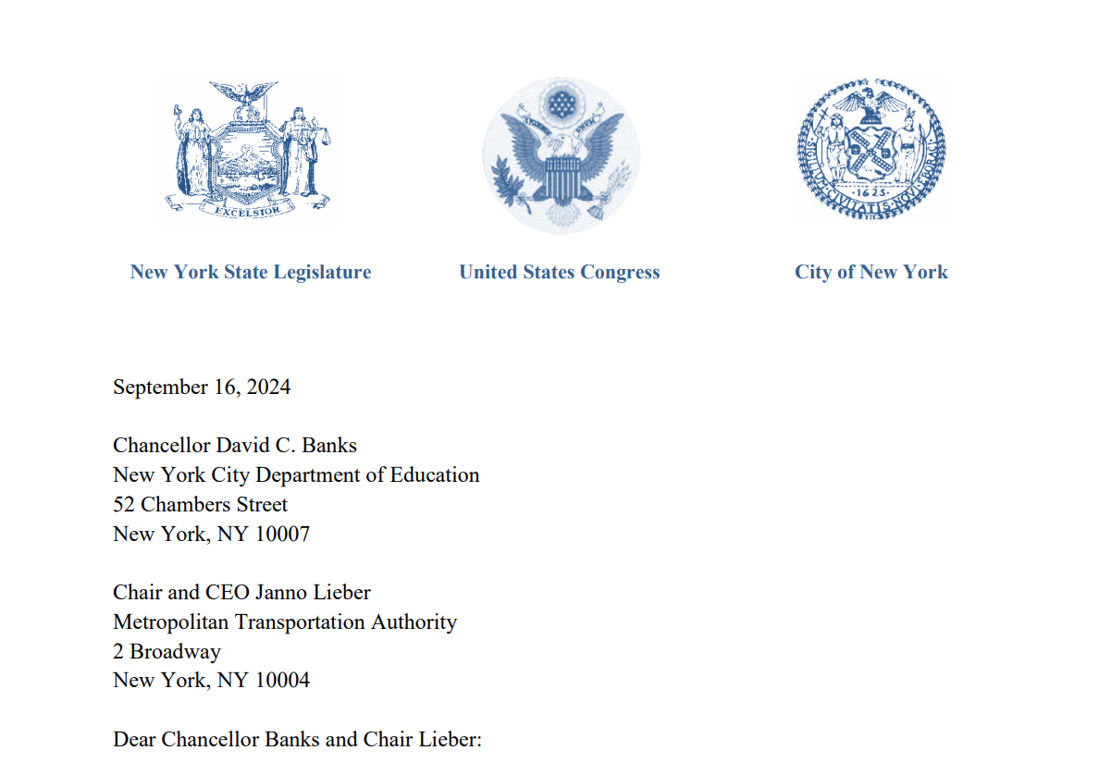
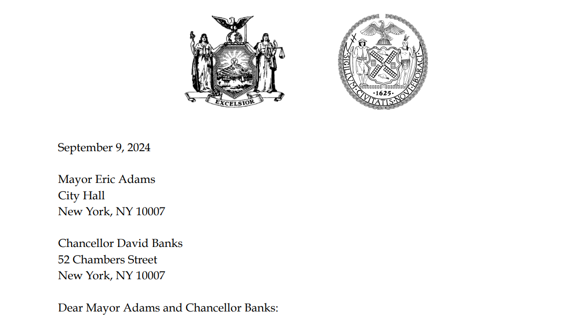

Previous Efforts
Senators Hoylman-Sigal and Kavanagh, along with numerous supporters, have each authored letters to NYCPS and MTA regarding expanded eligibility.
Letters from Elected Officials
Initial CEC Resolutions
7 CECs have previously passed resolutions addressing certain issues with student OMNY in 2024.

Slide 4



Steps Taken So Far
Launched our petition in May 2025 - now 200+ signatures
Met With MTA and PCAC
Supportive resolutions from 5 CECs in 4 boroughs
Connected with DOE OPT for initial discussions
Looking ahead
Supportive resolutions from more CECs to expand the reach of our campaign
Exploring school-level issues through student surveys
Advocating for digital rollout and accountability

Slide 5
Universal Access
Any student living within a 0.5 mile radius from their school and yellow bus riders are not eligible for a Student OMNY card.
73.5%
$4,380
$50.5M
NYC students who are economically disadvantaged
Monetary value of Student OMNY card
Estimated cost of expanding eligibility for 500,000+ students

Slide 6


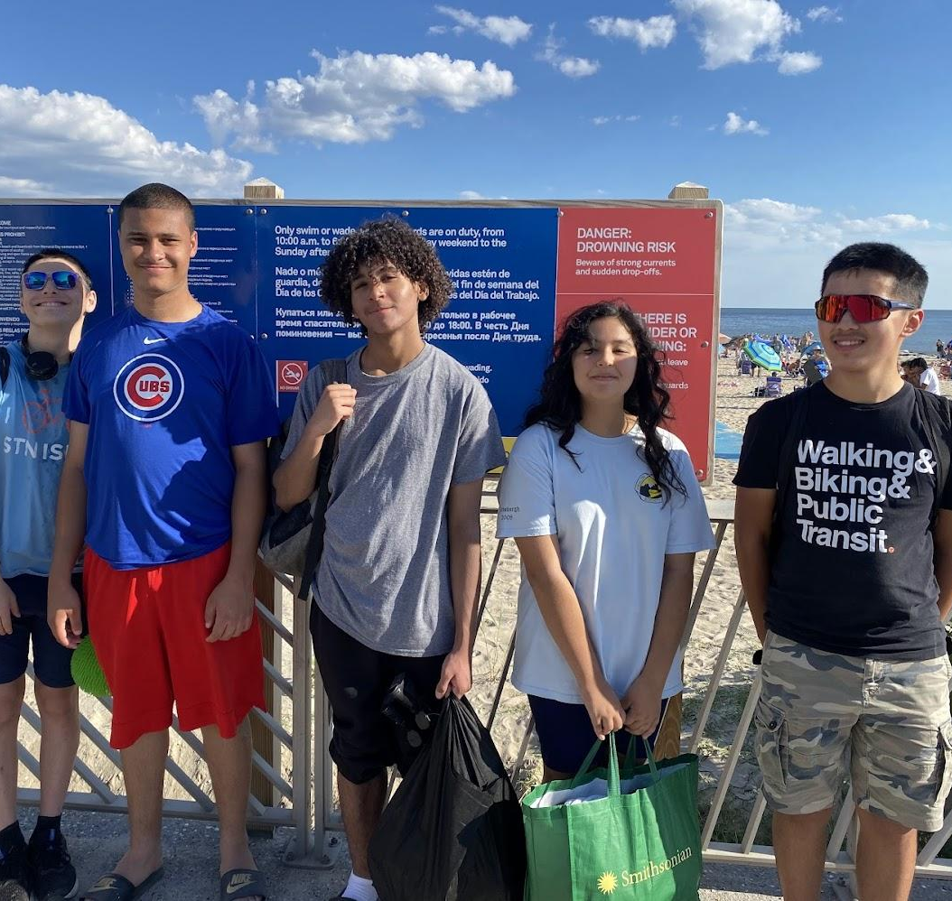
Unlimited Rides for all NYC students
NYC is lagging behind
Several cities already offer unlimited free transit for students: DC, Denver, LA, and Honolulu being a few!
Fare-capping already exists!
With a traditional OMNY card, users don’t have to pay after 12 rides in a week.
We have places to be…
Limiting student travel to 4 trips a day doesn’t always cut it. We should be able to explore our city!

Slide 7

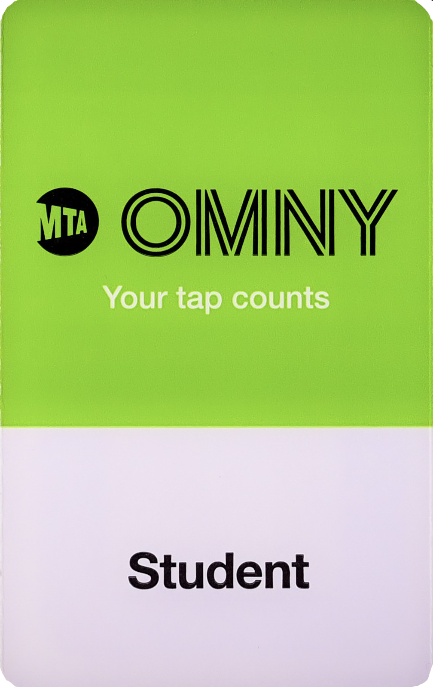

Clear Communication before deactivation
Reality:
students can be unexpectedly denied access due to deactivation.
Goal:
students get where they need to go!

Slide 8
Students’ cards are deactivated, lost, or buggy
A Faster and More Reliable Replacement Process
The current process of replacing OMNY cards is SLOW, a faster process is imperative!
Schools quickly run out of replacement cards with the number of students who need new cards
2+ weeks
for new cards to arrive at schools
Students’ have to choose between paying out of pocket, the cost of which can add up, or fare evade, which creates confrontations with the police, in the 2 weeks they are waiting for a new card

Slide 9
What You Can Do
1.
Adopt a comprehensive resolution in support of universal access, unlimited rides, communication before deactivation, and greater reliability with the replacement process.
2.
Push for updates to chancellor's regulation A-801 that address the issues and keep the policy current.
3.
Contact your elected officials and encourage them to fund expanded Student OMNY.
4.
Spread our petition to other parents, students, and groups affected by the issues with student OMNY.
https://act.transalt.org/a/expand-student-omny

Slide 10
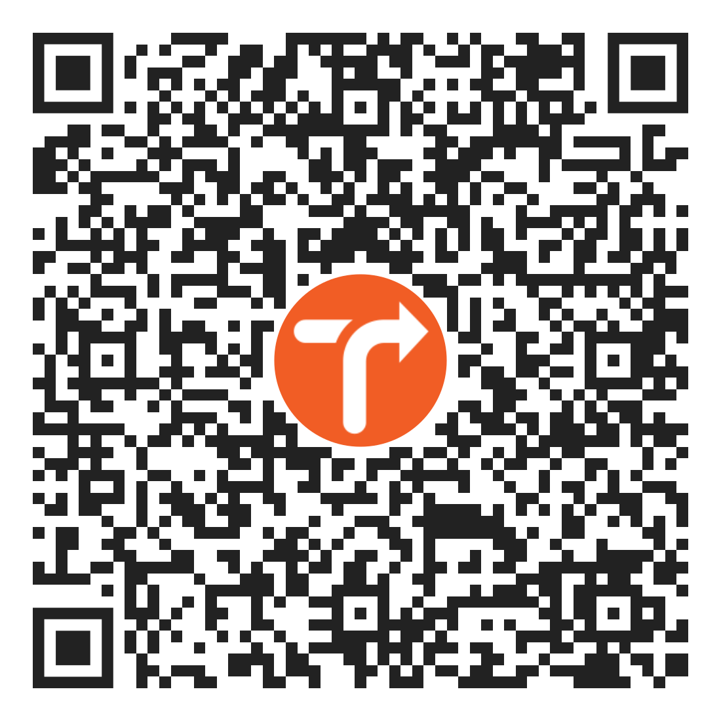

THANK YOU
Any Questions?
Sign our petition here
youth@transalt.org
transalt.org/youth

